Slide 1
Welcome Fundamentals in Practical Leadership for New & Emerging Leaders
Session 7: Improving Outcomes: Essential Evaluation and Quality Improvement Tools
“Evaluative thinking is a way of doing business…
[It] is what characterizes learning organizations” – Michael Quinn Patton.
We’ll begin at Noon

Slide 2
Essential quality improvement and evaluation tools that will help you to ensure you are making a difference in the programs/services and initiatives you are involved with.
There are funder requirements that need to be met, and then there are questions of impact that you and your team might have. How do you select the aspects that you may wish to evaluate? How do you engage your team in creating a learning culture?
By the end of today’s session, we want you to walk away with an evaluation and quality improvement mindset and leave feeling able to incorporate evaluation and quality improvement in the work you do.
Purpose

Slide 3
Our Time Together
What do emerging/aspiring leaders need to know about evaluation?
Today:
Introduction to evaluation basics
Mix of theory, examples and hands-on application
Notes:
(American Evaluation Society) “Though we are surrounded by evaluation, evaluators sometimes have trouble explaining their profession. The usage, value, and need for evaluations is not always commonly understood by outsiders. Even within our membership, how evaluation is defined can differ greatly based on field, background, education, or interest.
To provide insight into the purpose and focus behind evaluation, we have asked a few of our members to speak to what evaluation means to them, how they approach evaluation, and what they find rewarding in their work.”
https://www.eval.org/page/what-is-evaluation

Slide 4
Ways to Participate
Questions Box/Comments
Audio
Interactive polls
Handouts
Lines muted, if you ‘raise your hand’ we will unmute

Slide 5
Great Communicators
From your experience what makes for an effective evaluation project?
From your experience where does evaluation fall short?
www.PollEv.com/cfoe
(skip entering your name)

Slide 6
What is Evaluation?
What?
A systematic process of collecting information for a specific purpose and use
Action oriented
A tool to help organizations make decisions and to take appropriate action
Evaluation can be a simple reflection on how a program went to a comprehensive research project
Video

Slide 7
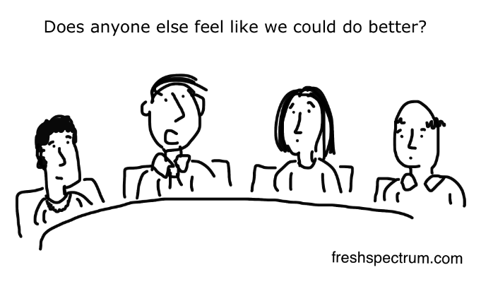
Evaluation is used for:
Program improvement and learning
Accountability to funders
Prioritize resources
Help determine the case for a program
Provide credible information to share with your Board, committees and participants/clients
Learn what needs to be done to make your programming stronger
Outcomes will be stronger because measuring results produces results!
Why?

Slide 8
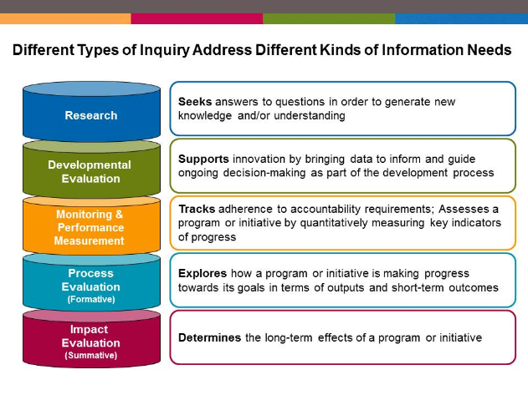
Common Types of Evaluation
Source: Gopal, S & Preskill, H.
Notes:
Broad purposes:
Make a judgement of merit or worth – summative evaluation
To improve a program – formative
To support design and development of an innovative program
To create new knowledge
Evaluations can focus on program outcomes, on program implementation and process. They can ask questions about relevance, performance, impact.

Slide 9
Core standards provide a framework for practicing evaluation.
Utility
Feasibility
Propriety
Accuracy
Accountability

Slide 10
Describe the context for the evaluation
Stakeholder analysis
Basic program description
Focus the evaluation questions
Determine indicators, data sources, data collection and plan for analysis
Develop data collection tools
Report
Communicate results
Develop actionable ideas/ recommendations
Determine next steps
Evaluation Process
Analyse by data source
Synthesise across data sources
Interpret – so what
Implement and monitor data collection
Adapt plan if needed

Slide 11
Program evaluation
One way of many…..
The template (handout)

Slide 12
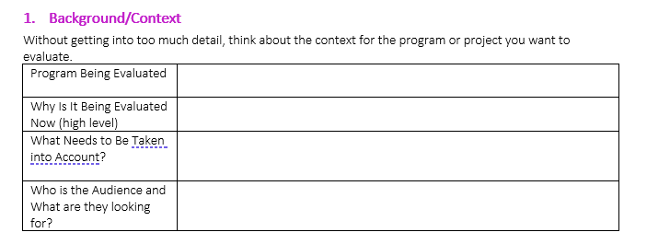
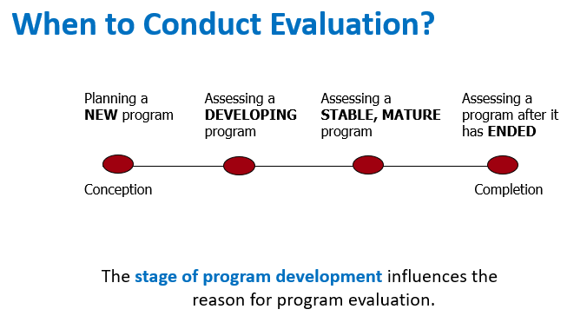
1. Background/Context
PLAN
Why now?
“red flags”, meet funder requirements, pre-determined timing, potential for future funding
What do I need to consider?
Budget, timing, stage of development
Audience
Department head, Board, Funder

Slide 13
2. Stakeholder Analysis
Stakeholders are those with a vested interest in the evaluation process or results
Who will be affected by the evaluation’s process or its results? | Program staff, program participants
Who else might contribute to the success of the evaluation? | Community partners
Who is going to use the evaluation? | Decision makers, Funder, Advocacy group
Who supports the evaluation? Who opposes it? | Board, Staff, Participants
Pregnant teens targeted by the program - Participants contribute perspective on strengths, weaknesses, benefits etc. Non-participant contribute perspective on barriers, relevance. May or may not have interest in being part of evaluation. Ethical and equity considerations: any potential/risk of harm if they participate in evaluation? Do all participants have equal opportunity to participate in evaluation project?
PLAN
Community partners - they might be able to help with connections to non-participants. They could also be affected if they refer teens to the program. They may have perspectives on program need, referral process
The program manager wants to use this evaluation to decide how to enhance it and how it can be streamlined.
Some staff are nervous of an evaluation. They are concerned that the program might be discontinued.
Tip from the field:
Identify stakeholders at outset and prioritize those who have highest vested interest
Involve early because their perspectives may influence how evaluation is carried out
Establish communication/reporting plan – who needs to be involved, when and how
Notes:
Stakeholder analysis

Slide 14
3. Basic Program Description
Logic Model Components | Your Program
Inputs: Investments (human resources, materials etc)
Activities: What will be/was done
Target groups: Who will be/was reached
Short term outcomes: Desired changes in knowledge, attitude, behaviour
Desired Long term impact on condition, circumstance, status
 | Program Description | Related Evaluation Questions (examples)
Who | Who is intended audience? Who else is involved and how? | Who are you really serving? How does this compare to what was planned?
What | What will be done? What is expected to change | What was actually delivered? How does this compare to what was planned? Evidence of change?
Where and When | Where is program running and what is the scheduling? | How do these affect program delivery and participation?
How | How does it work? What is the conceptual approach? What is the model it follows? | What does this look like in practice?
Why | Why do we believe this program will be effective? | To what extent are we achieving results expect?
PLAN
Pregnant teens
Staffed by peers and public health nurses
Deliver a drop-in education and skill building program program so teens will make healthy prenatal choices and have healthy birth outcomes
Neighbourhood community centre
After school | Weekly
“trauma-informed” approach
Safe space
Program is based on “best practice” model
Notes:
Stakeholder analysis

Slide 15
4. Evaluation Purpose and Key Evaluation Questions
Purpose:
What will you use this evaluation for? (eg. Identify areas to improve? To see if it meets objectives? To see if it is effective?)
The program manager wants to use this evaluation to decide how to enhance the program it and how it can be streamlined. – improvement oriented, focusing on process and early outcomes.
PLAN
Key Evaluation Questions:
What part of your program do you want to know more about? | Evaluation Questions
Process Focus
To inform changes or improvements
Questions to ask: : What is happening…? Who….What….When…..Why…..Where….How…
Who is participating in the program?
How well are we delivering the program?
Outcome Focus
To identify results or effects of program
Questions to ask: : What changed, for whom, to what degree (knowledge, attitude, behaviour, skill, status, circumstance)
To what extent are program participants making healthier prenatal choices?
Tip from the field – Prioritize Questions (no more than 5-10 questions)
Are important to staff and stakeholders
Align with purpose of evaluation, logic model, funder requirements
Feasible to answer – resource wise and time wise
Address important program needs
Can be used to inform program improvements
Consider age of the program – is it too early to ask outcome questions?

Slide 16
5. Indicators – What Evidence Do You Need to Gather?
Key Evaluation Question | Indicator | Data to Collect | Data Source
What is the question you are focusing on? | Indicators specify how the evaluation question will be answered. What do you want to measure? | What data do we need collect to answer the evaluation question? | Where can we easily get this data?
PLAN
How effective is the program at engaging the target population?
# of participants who access the program at least once
% of participants attending more than half of sessions
Registration forms
Attendance records
# unique participants
# of times each person attends
Indicators: Specific measures that answer the evaluation question
For example: “What information will tell us that change occurred, that the program has been delivered in the intended manner, or that the intended target population has been reached?” Questions to help determine measurable indicators:
How will I know if an objective has been accomplished?
What would be a success?
What would be considered effective?
What change is expected (outcome evaluation)
Data can be quantitative (numbers) or qualitative (what people say, what you read in documents)
Data can come from participants, program records, program staff, community partners

Slide 17
6. Data Collection – How Will You Gather and Analyse the Date Collected
Data Collection Method | When Will the Data Be Collected and Who Will Do It? | Implementation Steps (ensuring it is doable) | How Will This Be Analyzed?
Database, surveys, focus groups, point-in-time data collections, experience based co-design, process mapping | Ongoing, at the end of the program? To be collected by program staff? Evaluator? | Example: need to develop and pilot a survey instrument or interview questions, create forms for record program data | Thematic analysis of qualitative data using Word Descriptive statistics of quantitative data using Excel?
PLAN
Program records – attendance, registration
Data is collected ongoing by program staff
Set up system for recording the information so that it can be used to pull the information needed
Use excel for simple tabulation and calculations of descriptive statistics. Compare results to targets set
Implementing Data Collection
Who is responsible for collecting the data?
When will the data need to be collected?
Where do you need to collect baseline data?
What kind of data management system will you need?
How do you plan to analyse the data to answer the question?
Good Practices for Data Management
Check data early and check often
Effective processes for collecting and recording data
Record in appropriate format
Depersonalize information**
“Clean” the data – missing data, errors
Data Analysis
Quantitative – start with descriptive statistics – (average, mode, range, frequency)
Qualitative – read through once, read through looking for themes and patterns
Compare and contrast between groups (gender, age, etc – equity analysis)
Can use excel and word for a lot

Slide 18
Evaluation Matrix: Putting it all Together
One example of an evaluation matrix; a tool for visualizing and summarizing an evaluation design.
All together now
Evaluation Questions | Indicators | Data to Collect | Data Source | Collection Method | Responsibility and Timing | Analysis Plan
What is the participant’s experience with the program?
Program strengths and weaknesses
Participant feedback –
Location,
Schedule,
Content,
Overall quality
All program participants including those who have left the program
Interviews with a few people and surveys
Evaluator
Design and pilot instruments – May
Administer - June
Thematic analysis of interviews and open-ended survey questions
Summary of survey results

Slide 19
DO, STUDY, ACT
IMPLEMENT AND USE THE EVALUATION

Slide 20
Study: Analyze and Synthesize
Study
Analyze by data source – quantitative, qualitative
Synthesize across data sources to answer evaluation questions
Compare results to definition of success:
E.g. Program manager set a target of 100 people participating
Actual results: 120 people participated
Therefore, program was successful at engaging people to participate
Conclusions integrate answers to evaluation questions at a high level
What is working, what could be done better, areas for study

Slide 21
Act – Recommend, Report, Communicate, Next Steps
Act
Recommendations – what is next for the program? Include specific recommendations for things to change in the short term and more general recommendations for changes that need a plan and time
1
Reporting and Communicating – these are ongoing and integral.
Develop an internal reporting plan including progress updates and external communication plan
2
Next Steps – how will you use what is learned?
3

Slide 22
Resourcing Your Evaluation
Resourcing
Evaluation budget
Depends on size of program, importance of program, type of decisions being made
Can be “shoestring” up to 15% or even more
Internal evaluator or external evaluator? Key issues: expertise, need for impartiality, cost and time
Process evaluation - often internal evaluator
Summative and Outcome evaluation – often external evaluator
Can be a mix

Slide 23
INDICATORS OF AN EVALUATION CULTURE
Evaluation is central to the work rather than an add-on, end-of-project activity
More than a compliance activity
There is thinking about the kinds of information needed for learning and improvement
You reflect together on evaluation findings, lessons learned
There is intention to implement improvements based on what is learned
High-quality evaluations feed into program and organizational decision-making
Time and resources are allocated for reflection on evaluation findings and using those findings
You share what you learn with your stakeholders and explain how it informs decision-making
For an organization to develop and sustain evaluative capacity, it must have leaders, who, at the very least, not only value evaluation and learning, but more importantly, practice evaluative thinking (Evaluation for Leaders)
Sources: Michael Quinn Patton and Community Literacy of Ontario

Slide 24
Reflection Questions – Post Webinar – for Certificate Participants
Reflection
Due by the next webinar – January 25, 2021 (12pm)
Email to webinars@cfoe.ca
When it comes to having an evaluation mindset, where are you at? Your team? Your organization? What needs to be strengthened? How could you contribute to strengthening the culture of learning in your organization? (Maximum 1 page)
Complete the Evaluation Plan Template that we used during this session for one evaluation question that is important at this time. What challenges do you anticipate in implementing the evaluation and how might you address them?
How are you leaving?

Slide 25
Tools, Resources and References
Image source: https://openclipart.org/share
Creative Commons Zero 1.0 License.

Slide 26
General Resources and References
References
American Evaluation Association. “What is Organizational Evaluation?” Eric Barela https://www.youtube.com/watch?v=cI5wdWNOt4k
Better Evaluation. https://www.betterevaluation.org/en/manage-evaluation
Canadian Evaluation Society. Foundations of Evaluation. Essential Skills Series.
Community Literacy Ontario: Developing a Culture of Evaluation Project. http://www.communityliteracyofontario.ca/evaluation-culture/
Evaluation for Leaders. Your Strategic Management Tool. https://evaluationforleaders.org/
Gopal, S & Preskill, H. FSG. Reimagining Social Change. What is Evaluation, Really? www.fsg.org/blog/what-evaluation-really
Lysy, Chris. 111 Evaluation Cartoons for Presentations and Blog Posts. https://freshspectrum.com/evaluation-cartoons/
Office of Teaching & Digital Learning. Boston University School of Public Health. MPH Modules. Program Evaluation. https://sphweb.bumc.bu.edu/otlt/mph-modules/ProgramEvaluation/index.html
Ontario Center of Excellence for Child and Youth Mental Health. Resource Hub. Evaluation Module 1: Planning Evaluation
Patton, Michael Quinn (2014). Evaluation Flash Cards: Embedding Evaluative Thinking in Organizational Culture. St. Paul, MN: Otto Bremer Trust, ottobremer.org.
Additional Resources
Bowen, S. PhD., 2009. Guide to Evaluation in Health Research. Canadian Institutes for Health Research http://www.cihr-irsc.gc.ca/e/45336.html#a4.2
Health System Information Project, 2008. The Health Planner’s Toolkit. Evaluation Module 6.
Making Sense of Evaluation: A Handbook for Everyone. http://www.superu.govt.nz/resources/handbook . This 50-page handbook is a user-friendly, award-winning guide to measuring and understanding program effectiveness. Targeted for people working in the social sector and beyond. Great blend of theory and practice.
Social Research Methods and Program Evaluation. What is program evaluation: A set of beginners guides to Program Evaluation and Social Research Methods http://gsociology.icaap.org/methods/BasicguidesHandouts.html and Free resources for program evaluation and social research methods. https://gsociology.icaap.org/methods/index.html
U.S. Dept. of Health and Human Services Centers for Disease Control and Prevention, 2011. Introduction to Program Evaluation for Public Health Programs: A self-study guide.
Resources

Slide 27
Stakeholder Engagement - Practical Tools
Engaging Stakeholders to Select Evaluation Questions
Downloadable guide and webinar from FSG.
https://www.fsg.org/tools-and-resources/practical-guide-engaging-stakeholders-developing-evaluation-questions-0
Stakeholder Interest and Anxiety Questions – Public Health Ontario. Evaluating Health Promotion Programs. see page 16, table 3
Ethical Considerations
Evaluators: https://evaluationcanada.ca/ethics; http://einstitute.evaluationcanada.ca/product/course-on-research-ethics/
Resources and Tools for Community Based Research: Community Research Ethics Office. http://www.communityresearchethics.com/
Resources
Logic Model, Indicators, Evaluation Questions
Innovation Network. Logic Model Workbook.
http://www.pointk.org/client_docs/File/logic_model_workbook.pdf
Criteria for Selection of High Performing Indicators
https://wmich.edu/sites/default/files/attachments/u350/2014/Indicator_checklist.pdf
Evaluation Questions Checklist for Program Evaluation
https://wmich.edu/sites/default/files/attachments/u372/2016/eval_questions_checklist-2016-03.pdf
Notes:
These two resources from FSG are a resource you might want to add to your library. The downloadable document includes worksheets and suggestions for different engage stakeholders as well as techniques for selecting and prioritizing stakeholders.
The webinar is a 57 min presentation that includes real life examples.

Slide 28
Thank you!
Maria Sánchez-Keane
maria@cfoe.ca
519.636.3887
Gerda Zonruiter
gerda@cfoe.ca
519.932.0535

